Slide 1
Antimicrobial and antioxidative activity of Eryngium amethystinum L.

Slide 2
Introduction
Eryngium amethystinum is a videly distributed Mediterranean plant
Essential plant in Italian and Turkish etnopharmacology
Potential diuretic and laxative
The lack of deeper evidences- chance for further investigation

Slide 3
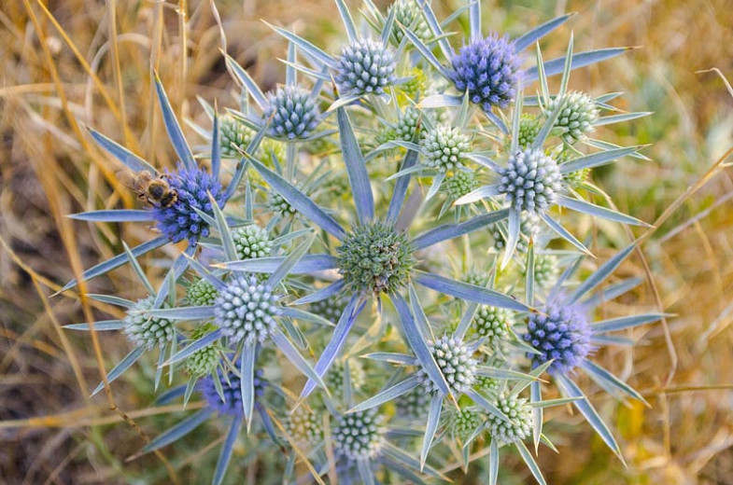
Picture 1 – Eryngium amethystinum L.
Source – www. gardenia.net

Slide 4
Material and methods – the plant
The aerial parts were collected in Central Bosnia
Scientifically recognized by Department of Botany, University of Banja Luka
The plant was stored at 20 degrees Celsius

Slide 5
Methods-testing of antioxidative activity
  DPPH essay was used for detection of activity
  Methanolic extract was used as starting material
  70-percent methanol was used as a vehiculum
  Absorbance was measured on 517 nm

Slide 6
Methods – detection of antimicrobial activity
4 Gram-positive and 4 Gram-negative bacterial strains were used to test the antibacterial activity of Eryngium amethystinum root extract:
S. aureus (ATCC 6538), S. epidermidis (ATCC 12228), S. pyogenes (ATCC 19615), E. faecalis (ATCC 19433); E. coli (ATCC 8739), P. aeruginosa (ATCC 9027), P. mirabilis (ATCC 12453), K. pneumoniae (ATCC 10031)

Slide 7
The results – antioxidative activity
The highest activity with IC₅₀ of 2.0 mg/mL was recorded in the water extract of E. amethystinum.
Vitamin C concentration was 0.1 mg/mL, which was determined in parallel experiment.

Slide 8
The results – antimicrobial activity
The extracts of E. amethystinum expressed an activity in the range between 0.31–20.00 mg/mL
S. pyogenes proved itself as the most resistant species
The strain most sensitive to the extracts of E. amethystinum was Klebsiella pneumoniae

Slide 9
Discussion
Eryngium amethystinum is a rich source of potential leading molecules which can be used in further analyses
Germacrene D was a dominant constituent in the oil obtained from the aerial parts of E. amethystinum
The main compounds of the oils were nonanoic acid, 2,3,4-trimethylbenzaldehyde

Slide 10
Discussion (2)
The highest activity with IC₅₀ of 1.7 mg/mL was recorded in the water extract of E. amethystinum
The tested essential oil from Eryngium amethystinum species proved significantly efficient, with emphasized inhibitory action against two Gram-negative strains (K. pneumoniae and P. mirabilis) and one Gram-positive bacteria strain (S. aureus) in all tested concentrations.

Slide 11
Conclusion
Eryngium amethystinum is a plant which offers a lot of opportunities to researchers, Preliminary works on it showed potential antioxidative and antimicrobial activity
The antioxydative activity with IC₅₀ of 2.0 mg/mL was recorded in the water extract of E. amethystinum. This level of activity is in accordance with claims of high antioxidative effect of water extract of E. amethystinum
E. amethystinum can be good basis for therapy of Klebsiella pneumoniae, due to low MIC of ethyl-acetate extract

Slide 12
THANKS FOR WATCHING!

