Slide 1


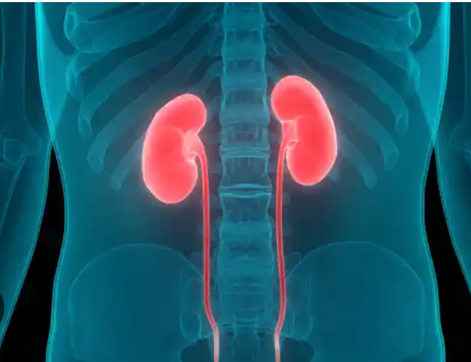

FREQUENCY OF VASCULAR VARIATIONS IN POTENTIAL LIVING KIDNEY DONORS IN UKC TUZLA
WHERE ARE WE TODAY?
Naida Morić, JZU UKC TUZLA

Slide 2




Transplantation data in Bosnia and Herzegovina
JZU UKC Tuzla
247
41

Slide 3

Overview
  Aberrrant renovascular anatomy and transplantation
  Correlation between Renal Artery Anatomy and Hypertension
  Resistant Hypertension
  Case report
01
02
03
04

Slide 4
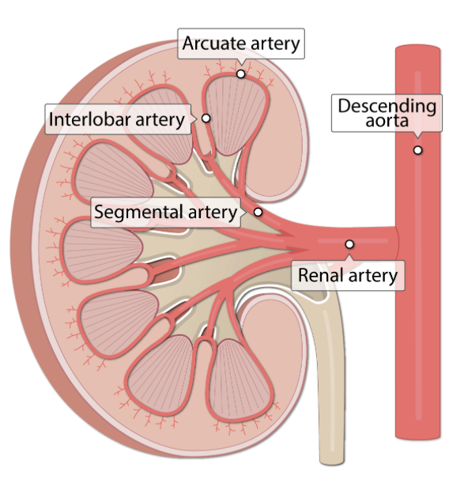




Nomenclature
  Any artery, other than main renal artery, arising from abdominal aorta to supply the kidney either by passing through its hilum or directly entering its poles.
  They are not extra but essential vessels
  Anatomical nomenclatures describing the accessory renal artery like-supernumerary, multiple, aberrant, additional
  Different incidences of accessory renal arteries ranging from about 11% to 61%
  Mutyalapati Venkata Ramulu, Lokadolalu Chandracharya Prasanna. Accessory renal arteries – Anatomical details with surgical perception. Journal of the Anatomical Society of India, (2016)
  S.A. Ames et al. Assessment of kidneys by magnetic resonance angiography and venography: accuracy and impact on outcomes. Am J Transplant (2005)
  F.T. Graves. The aberrant renal artery. J Anat (1956)

Slide 5

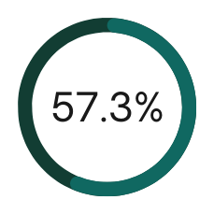

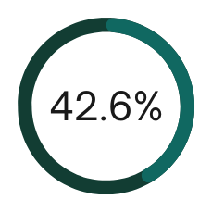
Statistics
A cohort of 136 potential kidney donors in living related kidney transplantation
Potential female donor
Potential male donor

Slide 6


statistics
37.56%
Out of 136 potential kidney donors 51 people had vascular variation

Slide 7
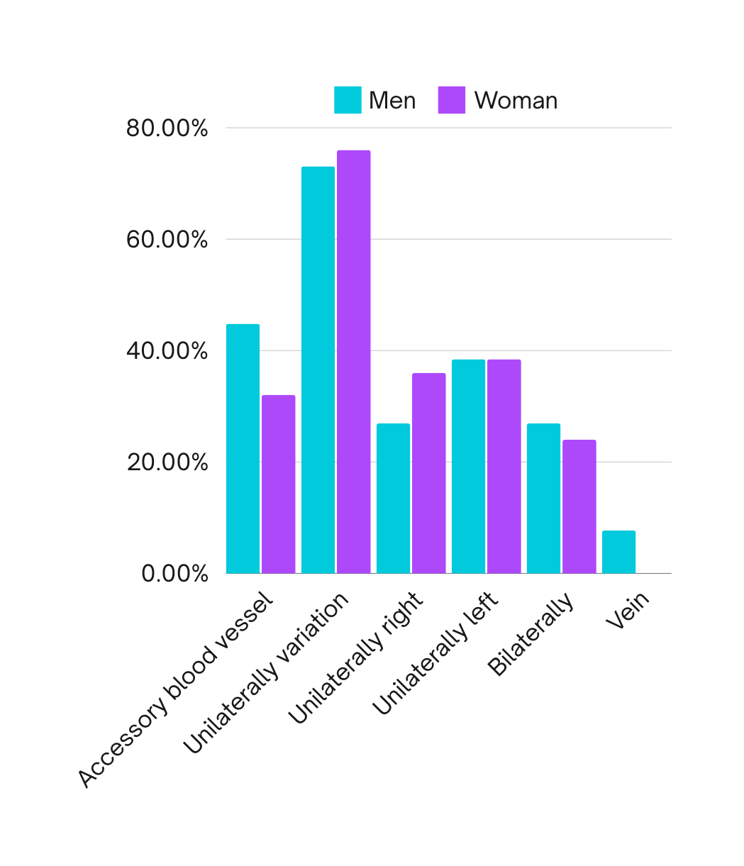
Statistics
51 out of 136 had some vascular variation
Transplantation outcomes
46 out of 51 potential kidney donors (90.19%)

Slide 8

Literature review
01
02
03
04
1979
1995
2012
2021
Fox M, Yalin R. Renal transplantation with multiple arteries. Br J Urol. 1979
Benedetti E, Troppmann C, Gillingham K, Sutherland DE, Payne WD, Dunn DL, Matas AJ, Najarian JS, Grussner RW. Short- and long-term outcomes of kidney transplants with multiple renal arteries. Ann Surg. 1995
Kamali K, Abbasi MA, Ani A, Zargar MA, Shahrokh H. Renal transplantation in allografts with multiple versus single renal arteries. Saudi J Kidney Dis Transpl. 2012.
Omar Salem Khattab Alomar,
Comparison between single and multiple renal vessels in live donor allograft kidney transplantation: Surgical aspects and outcomes, 25 years experience,
International Journal of Surgery Open, 2021.
  Ischaemic times were increased with those of kidneys with multiple arteries
  Incidence and duration of acute tubular necrosis and also the length of time spent in hospital were similar in both groups.
  Excessive bleeding and other complications were no more common than following single arterial anastomosis.
  Delayed graft function in recipients' allografts with single vs more than 2 arteries vs two arteries
  Renal artery stenosis (RAS) occurred more frequently in patients with MRA
  No significant differences among the three groups for the following variables: post-transplant hypertension, acute tubular necrosis, acute rejection, creatinine levels, early vascular and urologic complications, and graft and patient survival.

Slide 9
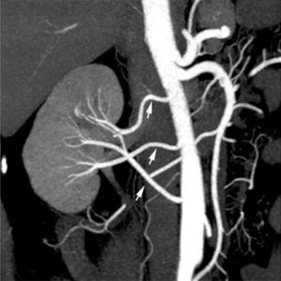
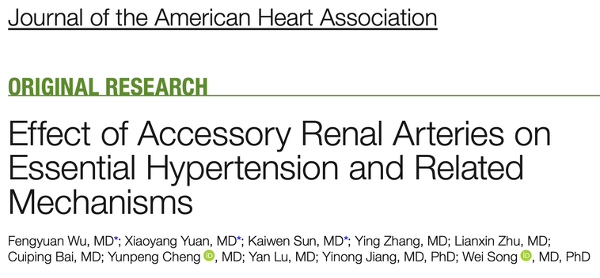
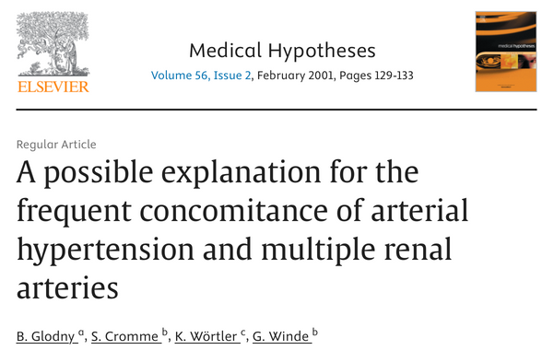
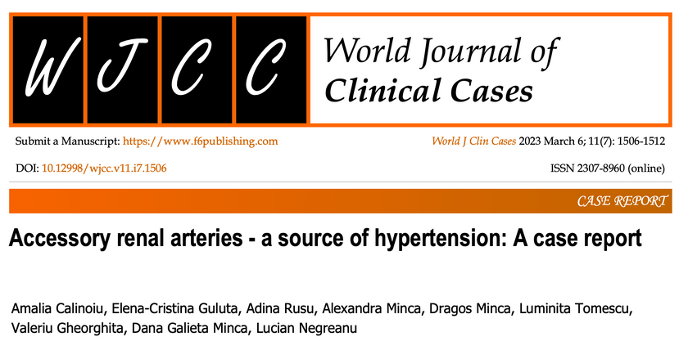

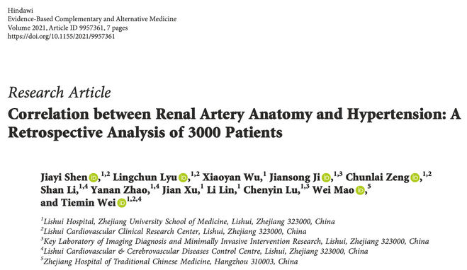
The presence of accessory renal artery is independent factor of hypertension
Shen J, Lyu L, Wu X, Ji J, Zeng C, Li S, Zhao Y, Xu J, Lin L, Lu C, Mao W, Wei T. Correlation between Renal Artery Anatomy and Hypertension: A Retrospective Analysis of 3000 Patients. Evid Based Complement Alternat Med. 2021 Dec 29;2021:9957361. doi: 10.1155/2021/9957361. PMID: 35003315; PMCID: PMC8731270.

Slide 10

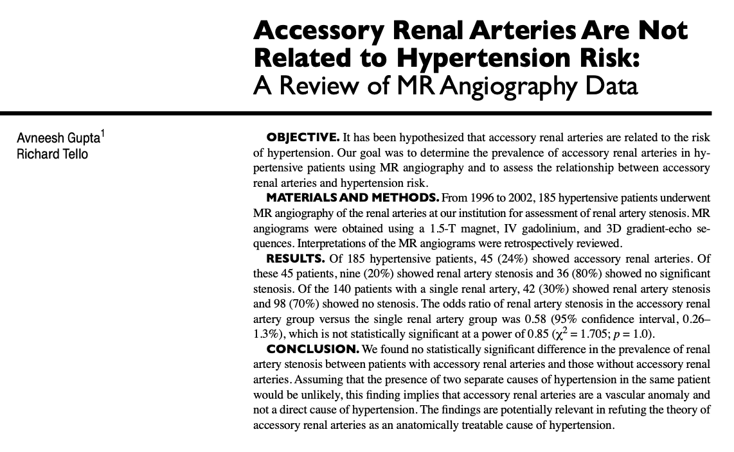

Stenosis
2004
hypertensive patients with accessory renal arteries vs those without accessory renal arteries

Slide 11



Studies showed that 10% to 13% of the patients did not respond to therapy
Effectiveness of Renal Denervation in Resistant Hypertension
Diversity in renal vascularization and innervation may complicate the renal denervation procedure
The lack of their complete denervation, reduces the procedure’s effectiveness.
Kasprzycki, K.; Petkow-Dimitrow, P.; Krawczyk-Ożóg, A.; Bartuś, S.; Rajtar-Salwa, R. Anatomic Variations of Renal Arteries as an Important Factor in the Effectiveness of Renal Denervation in Resistant Hypertension. J. Cardiovasc. Dev. Dis. 2023,
VonAchen, P., Hamann, J., Houghland, T., Lesser, J. R., Wang, Y., Caye, D., … Schwartz, R. S. (2016). Accessory renal arteries: Prevalence in resistant hypertension and an important role in nonresponse to radiofrequency renal denervation. Cardiovascular Revascularization Medicine

Slide 12



Mini case report
01
Female, 62y, donor renis
02
Hypertensio arterialis; Atherosclerosis generalisata;
03
CTA: The left kidney is vascularized by two renal arteries, of which the proximal (polar) artery is extremely gracile-rudimentary; Stenosis ostii arteriae renalis bilateralis incipiens (30%)

Slide 13



Take home messages
Multidisciplinary approach
Need for prospective analysis of the impact of these factors on hypertension
Addressing accessory renal arteries in future clinical trials may improve RDN therapeutic efficacy.

Slide 14










Thank's For Watching
Teamwork makes a dream work

