Slide 1
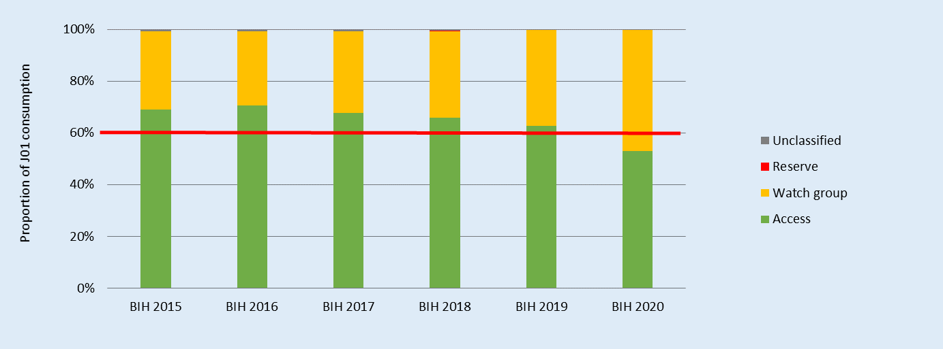
Specificity of Antimicrobial Consumption in
Bosnia and Herzegovina
Tijana Spasojević-Došen,
Agency for Medicinal Products and Medical Devices of Bosnia and Herzegovina, Banjaluka, Bosnia and Herzegovina
Department of Pharmacy, Faculty of Medicine University of Banja Luka, Banja Luka, Bosnia and Herzegovina
Purpose of the work
Presentation of continuous monitoring of antimicrobial drug consumption is very important, since consumption is associated with antimicrobial resistance. Data are collected and processed to be valid, representative and comparable to data on antimicrobial drug consumption in other countries.
Methods
Data on the total consumption of antimicrobial drugs in Bosnia and Herzegovina for the period 2014-2021. year were analyzed using the anatomical therapeutic chemical (ATC)/defined daily dose (DDD) methodology of the World Health Organization (WHO) and are expressed in DDD/1000 inhabitants/day (DID). For the period 2015 - 2017. were used DDD valid for the year, but also DDD valid from January 2019. Consumption was also analyzed using the AwaRe (Access, Watch, Reserve) classification of the WHO.
Results
Total consumption of antibiotic for systematic use (J01 group) was 17,5 DID in 2014, 19,0 DID in 2015, 20,8 DID in 2016, 20,3 DID in 2017, 19,3 DID in 2018, 17,4 DID in 2019, 19,2 DID in 2020. and 19,0 DID in 2021. By applying DDD values ​​valid from January 2019. (Table 1.) for the period 2014-2017. year, consumption of antibiotic for systematic use was 15,3 DID in 2014, 16,2 DID in 2015, 17,9 DID in 2016 and 17,4 DID in 2017. From 2018. the total consumption of antibiotic for systematic use is calculated using the DDD valid from January 2019. (Figure 1.)
Consumption by subgroups of antibacterial drugs (at the third level of ATC classification) in 2021. were: penicillins, ATC group J01C, 5.8 DID, (30,7% total consumption antibiotic for systematic use); macrolides, lincosamides and streptogramins, J01F 3.6 DID (19.1%); other beta-lactams (includes cephalosporins) J01D 2.8 DID (15 %); quinolone J01M 2.5 DID (13.4 %); tetracyclines J01A 2.2 DID (11.5 %), sulfonamides and trimethoprim J01E 1.3 DID (6.0%) and other J01 antibacterials (J01G, J01R, J01X) 0.8 DID (4.3%). (Figure 2.)
The first nine antibacterial drugs by consumption (at the fifth level of the ATC-classification) in 2021 were oral formulations: amoxicillin and enzyme inhibitor (2.86 DID), azithromycin (2.47 DID), amoxicillin (2.26 DID), doxycycline (2.19 DID), ciprofloxacin (1.74 DID), sulfamethoxazole and trimethoprim (1.14 DID), clarithromycin (0.91 DID), cefixime (0.77 DID) and cefalexin (0.75 DID). (Tabele 1, Figure 1)
Among the top ten antibacterial drugs oral formulation by consumption in 2021, there are four of them from the Watch group: azithromycin, ciprofloxacin, clarithromycin and cefixime (Table 2). Among the top ten antibacterial drugs by consumption in 2021. when it comes to parenteral formulations, there are even five from the Watch group: ceftriaxone, ciprofloxacin, meropenem, vancomycin and imipenem and enzyme inhibitor (Table 3.).
During consumption monitoring using the AwaRe classification in the period 2014-2019. year, the relative consumption of antibiotics from the Access group according to AwaRe is over 60%. In 2020 and 2021, the consumption of antibiotics from the Watch group increases, so the consumption of antibiotics from the Access group is less than 60%. (Figure 3)
Figure 1. J01 – total consumption on third level ATC classification, expressed in DDD/ 1000 inhibitans/ day (DID) in period 2014. – 2021. year using DDD values valid for january 2019. year
Ј01 – antibacterials for systematic use
DDD –defined daily dose
Figure 2. J01 – relative consumption on third level ATC classification
Antibacterial agents | Previous DDD | New DDD | ATC | Year of change
Temocillin | 2 g P | 4 g P | J01CA17 | 2019
Meropenem | 2g P | 3 g P | J01DH02 | 2019
Colistin | 3 MU P | 9 MU P | J01XB01 | 2019
Ciprofloxacin | 0,5 g P | 0,8 g P | J01MA02 | 2019
Cefepim | 2 g P | 4 g P | J01DE01 | 2019
Ampicilin | 2 g P | 6 g P | J01CA01 | 2019
Amoxicillin | 1 g P | 3 g P | J01CA04 | 2019
Amoxicillin | 1 g O | 1,5 g O | J01CA04 | 2019
Amoxicillin and beta-lactamase inhibitors | 1 g O | 1,5 g O | J01CR02 | 2019
Group | Agent | DDD/1000 inhabitants/day | Cumulative proportion (%)
Access | Amoxicillin and enzyme inhibitor | 2.86 (16%) | 16%
Watch | Azithromycin | 2.47 (14%) | 30%
Access | Amoxicillin | 2.26 (13%) | 42%
Access | Doxycycline | 2.19 (12%) | 55%
Watch | Ciprofloxacin | 1.74 (10%) | 64%
Access | Sulfamethoxazole and trimethoprim | 1.14 (6%) | 71%
Watch | Clarithromycin | 0.91 (5%) | 76%
Watch | Cefixime | 0.77 (4%) | 80%
Access | Cefalexin | 0.75 (4%) | 84%
Access | Ampicillin | 0.45 (2%) | 87%
Group | Agent | DDD/1000 inhabitants/day | Cumulative proportion (%)
Access | Amoxicillin and enzyme inhibitor | 2.86 (16%) | 16%
Watch | Azithromycin | 2.47 (14%) | 30%
Access | Amoxicillin | 2.26 (13%) | 42%
Access | Doxycycline | 2.19 (12%) | 55%
Watch | Ciprofloxacin | 1.74 (10%) | 64%
Access | Sulfamethoxazole and trimethoprim | 1.14 (6%) | 71%
Watch | Clarithromycin | 0.91 (5%) | 76%
Watch | Cefixime | 0.77 (4%) | 80%
Access | Cefalexin | 0.75 (4%) | 84%
Access | Ampicillin | 0.45 (2%) | 87%
Table 1. DDD changes valid from January 2019
Table 2. The 10 most consumed agents – oral formulation 2021
Table 3. The 10 most consumed agents – parenteral formulation 2021
Figure 3. J01 - relative consumption according to WHO AWaRe grouping
CONCLUSION
Total consumption of antibacterial drugs for systemic use in Bosnia and Herzegovina has increased. During 2020. and 2021. Bosnia and Herzegovina no longer satisfied the WHO requirement that at least 60% of the total consumption of antibacterial drugs is from the Access group. It is necessary to take measures aimed at more rational use of antimicrobial drugs.

