Slide 1

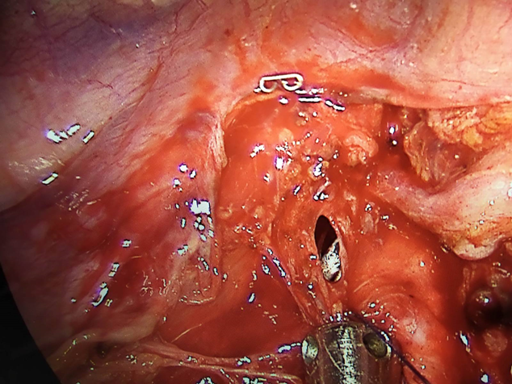
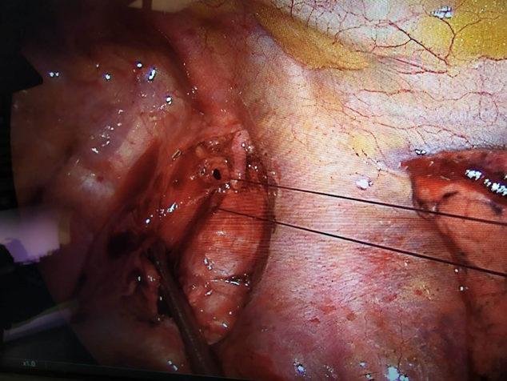
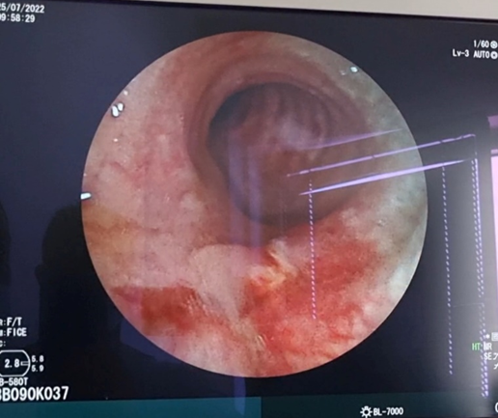
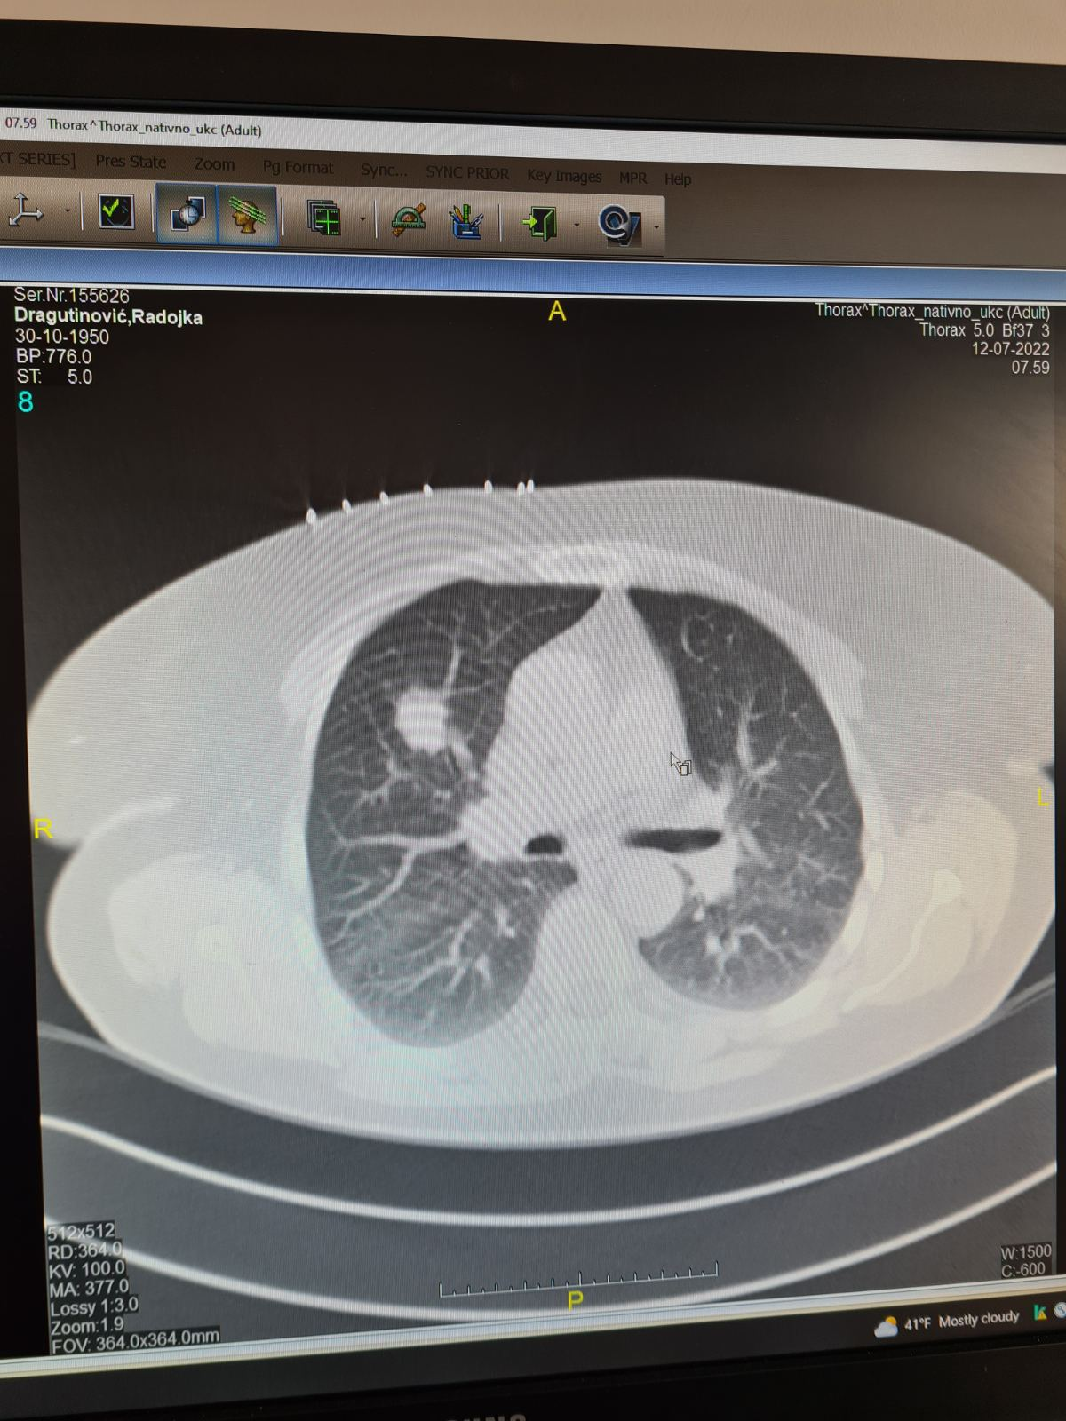
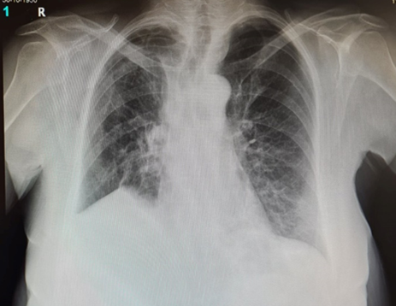
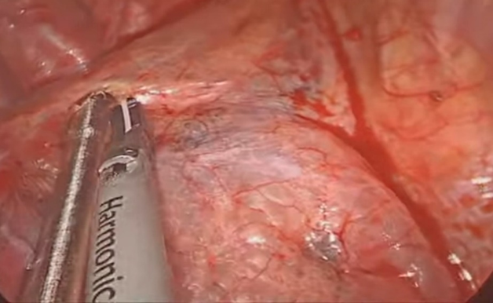
A CASE REPORT OF PERIOPERATIVE UVATS DETECTION AND CLOSURE OF POSTINTUBATION TRACHEAL LESION
Radovan Jurić¹
¹ University Clinical Centre of the Republic of Srpska, Clinic of Thoracic Surgery, Banja Luka, Bosnia and Herzegovina
INTRODUCTION
Post-intubation tracheobronchial lesions (PITLs) are rare but potentially life-threatening complications. The overall reported incidence is 1 case per 20,000 endotracheal intubations. Risk factors include double-volume intubation, emergency intubation, lack of anesthesiologist's experience, inadequate use of a guide tube, older age, female gender, and associated pathological conditions of the trachea such as tracheomalacia or tracheal stenosis. Most post-intubation tracheobronchial lesions occur in the pars membranacea of the cervicothoracic trachea, while tracheal injuries caused by high pressure or volume ventilation occur in the pars membranacea and pars cartilaginea of the tracheal bifurcation and tracheobronchial region.
Signs of a tracheal lesion include soft tissue emphysema of the neck and/or mediastinum, pneumothorax, dyspnea, and hemoptysis. The diagnosis is made by tracheobronchoscopy, which reveals the location and size of the lesion.
Treatment can be conservative, for lesions under 3 cm, and surgical, depending on the size and localization of the lesion. Recommendations for conservative treatment are small tracheal lesions without any clinical or radiological signs of mediastinal involvement. This method requires careful monitoring with bronchoscopy and CT. If it is possible to place the cuff of the endotracheal tube under the lesion, or spontaneous breathing is not accompanied by respiratory distress and there are no signs of an infectious syndrome - conservative treatment is also justified. Another reason for recommending conservative treatment is the unacceptably high anesthetic and/or surgical risk. Based on the literature, surgical intervention is advised in case of complete rupture of the tracheal wall, problems with ventilation or surgical drainage of the mediastinum is necessary. It must be taken into account that the published mortality rate in conservatively treated patients is higher, and as soon as clinical deterioration occurs, the conditions for surgical rehabilitation are also more difficult.
METHODS
In July 2022, a 73-year-old female patient was hospitalized in the Clinic for Thoracic Surgery of the University Clinical Center of the Republic of Srpska for an elective Uniportal VATS upper right lobectomy due to CT-verified and cytologically confirmed Adenocarcinoma, clinical stage cT1cN0. CT of the thorax: in the S3 segment of the right lung, there is a lobular tumor infiltration with a diameter of 22x16x17mm with visible marginal infiltrations. ECOG 0; RCRI 1; FEV1 126%; stair-climbing test >22m.
Figure 1. CT of the thorax with the described change in S3
After the induction of general endotracheal anesthesia with a double-lumen tube, the patient is placed in the left lateral position, - uniportal VATS approach: immediately after entering the pleural cavity with the telescope, a massive pneumomediastinum is recorded (Figure 2) and the existence of a tracheal lesion is suspected. After the upper right lobectomy, the lower pulmonary ligament is separated, and then dissection of the mediastinal and hilar lymphatics is performed. After paratracheal dissection, a lesion of the membranous wall of the trachea was observed at the level of the upper thoracic aperture, 7 mm in length (Figure 3). After rotation of the cervicothoracic trachea using endoscopic techniques - direct sutures with Vicryl 4/0, the lesion is closed with individual stitches, and additionally strengthened with a parietal pleura (Figure 4).
Figure 2. Pneumomediastinum
Figure 3. Tracheal lesion Figure 4. Direct sutures of the lesion with Vicryl 4/0
RESULTS
Our decision for surgical treatment was based on the fact that we were already in the operative field, and to prevent potential complications such as prolonged air loss, empyema, respiratory failure, mediastinitis and prolonged hospital stay. After treatment of the lesion on the membranous wall of the trachea, the air-leak test at the end of the operation is without signs of air loss. Extubation immediately after the operation, without air loss in the following days of hospitalization, and on the sixth postoperative day, a control bronchoscopy was performed, which showed normal findings.
Figure 5. Bronchoscopy findings on the sixth postoperative dayy
Bronchoscopic finding: on the membranous wall of the middle third of the trachea, there is a healed injury, without signs of fistulization.
Figure 6. Control radiograph on the eighth postoperative day
CONCLUSION
This case showed that even small lesions of the trachea can cause massive pneumomediastinum, and can be complicated by potentially life-threatening complications. Treatment of post-intubation lesions of the trachea can be conservative for lesions smaller than 3 cm and surgical depending on the size and location of the lesion. We have shown that tracheal lesions at the level of the upper thoracic aperture can be treated with a minimally invasive technique such as uniportal VATS with the aim of preventing potentially threatening complication.
LITERATURE
[1]Maxeiner H. Weichteilverletzungen an kehlkopf bei notfallmaessiger intubation,Anaesth Intensivmed, 1988, vol. 29 (pg. 42-49) [in German] [2]Borasio P., Ardissone F., Chiampo G.. Post-intubation tracheal rupture. A report on ten cases, Eur J Cardiothorac Surg, 1997, vol. 12(pg. 98-100) [3]Personne C., Kleinmann P., Bisson A., Toty L.. Tracheobronchial tears caused by Carlens’ tube, Ann Chir, 1987, vol. 41(pg. 494-497) [in French] [4]Spaggiari L., Rusca M., Carbognani P., Solli P.. Tracheobronchial laceration after double-lumen intubation for thoracic procedures, Ann Thorac Surg, 1998, vol. 65(pg. 1837-1839) [5]Massard G., Rougé C., Dabbagh A., Kessler R., HentzJ.G., Roeslin N., Wihlm J.M., Morand G..Tracheobronchial lacerations after intubation and tracheostomy, Ann Thorac Surg, 1996, vol. 61(pg. 1483-1487) [6]Marty-Ané C.H., Picard E., Jonquet O., Mary H.. Membranous tracheal rupture after endotracheal intubation, Ann Thorac Surg, 1995, vol.60(pg. 1367-1371) [7]Jougon J., Ballester M., Choukroun E., Dubrez J., Reboul G.,Velly J.-F.. Conservative treatment for postintubation tracheobronchial rupture, Ann Thorac Surg, 2000, vol. 69(pg. 216-220) [8]Dienemann H, Hoffmann H. Tracheobronchial injuries and fistulas, Chirung, 2001, vol. 72(pg. 1130-1136) [9]Tsunezuka Y, Sato H, Hiranuma C, Ishikawa N, Oda M, Watanabe G. Spontaneous tracheal rupture associated with acquired tracheobronchomalacia, Ann Thorac Cardiovasc Surg, 2003, vol. 9(pg. 394-396) [10]Carbognani P,Bobbio A, Cattelani I, Internullo E, Caporale D, Rusca M. Management of postintubation membranous tracheal rupture, Ann Thorac Surg, 2004, vol. 77(pg. 406-409) [11]Gabor S, Renner H, Pinter H, Sankin O, Maier A, Tomaselli F, Smolle-Jüttner FM.Indications for surgery in tracheobronchial ruptures, Eur J Cardiothorac Surg, 2001, vol. 20(pg. 399-404) [12]D'Odemont JP, Pringot J, Goncette L, Goenen M, Rodenstein DO. Spontaneous favorable outcome of tracheal intubation,Chest,1995, vol. 99(pg.1290-1291) [13]Brosario P, Ardissone F, Chiampo G. Post-intubation tracheal rupture. A case report on ten cases, Eur J Cardiothorac Surg,1997, vol. 12(pg. 98-100) [14]Spaggiari L, Rusca M, Carbognani NP, Solli P. Tracheobronchial laceration after double-lumen intubation for thoracic procedures, Ann Thorac Surg,1998, vol.65(pg. 1837-1339) [15]Ross HM, Grant FJ, Wilson RS, Burt ME.Nonoperative management of tracheal laceration during endotracheal intubation, Ann Thorac Surg, 1997, vol. 63(pg. 240-242) [16]Kiser AC, O'Brien SM, Detterbeck FC.Blunt tracheobronchial injuries: treatment and outcomes,Ann Thorac Surg, 2001, vol. 71(pg.2059-2065) [17]Leinung S, Ott R, Eichfeld U. Tracheobronchial ruptures: classification and management, Chirurg, 2005, vol. 76(pg. 783-788)

