Slide 1

A CASE REPORT OF PERIOPERATIVE UVATS DETECTION AND CLOSURE OF POSTINTUBATION TRACHEAL LESION
Radovan Jurić
University Clinical Centre of the Republic of Srpska, Clinic of Thoracic Surgery, Banja Luka, Bosnia and Herzegovina

Slide 2
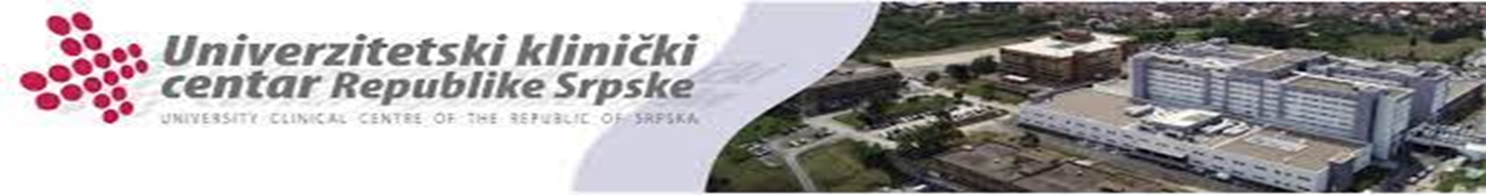
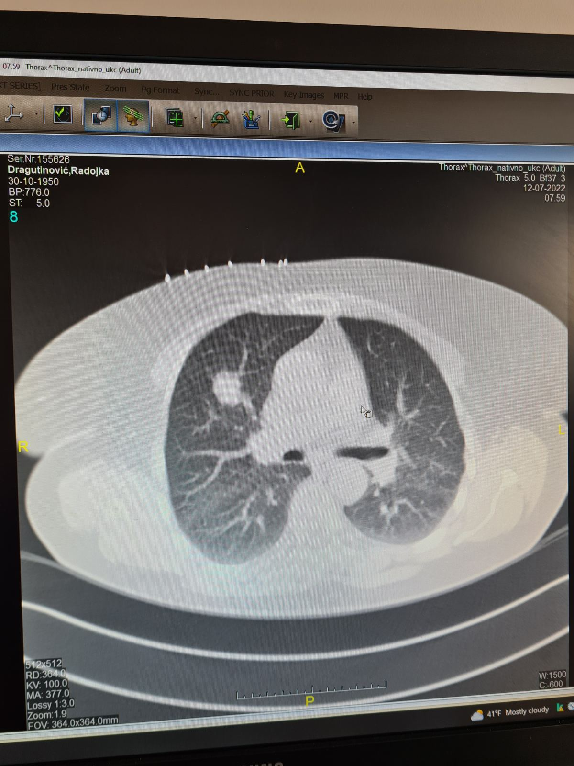
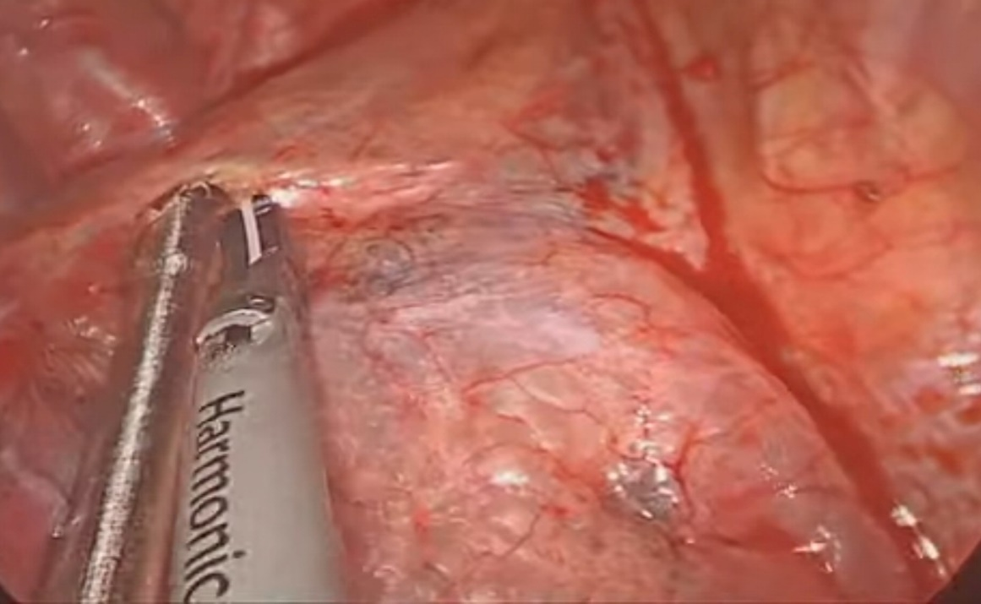
73 years-old female.
Adenocarcinoma, clinical stage cT1cN0.
Plan: UVATS right upper lobectomy.
Telescope exploration – massive pneumomediastinum.
Next step: RUL and mediastinal node dissection.

Slide 3
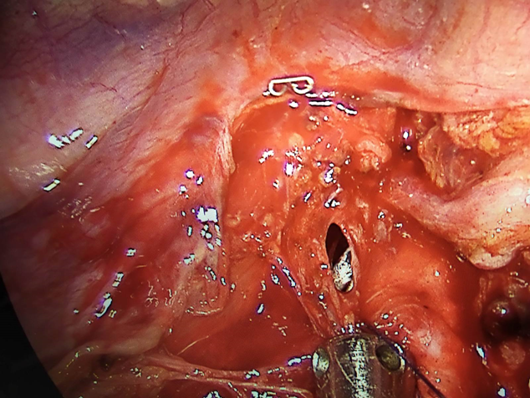
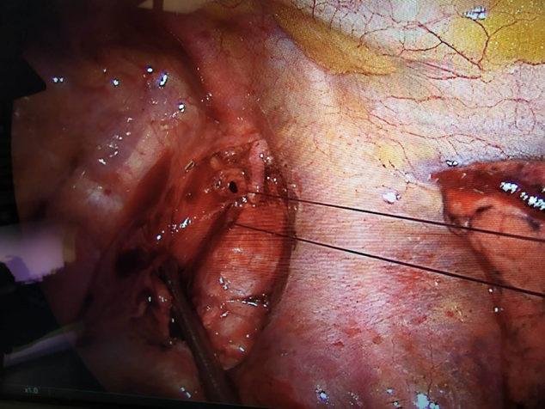
A lesion - in the level of thoracic inlet.
Length of lesion 6mm.
Direct sutures Vicryl 4/0 .
Suture line buttressed by pleural patch.

Slide 4

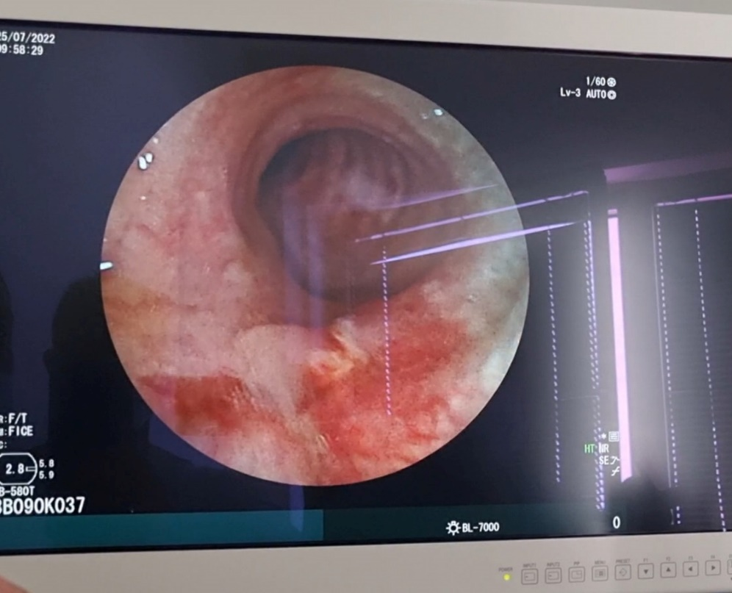
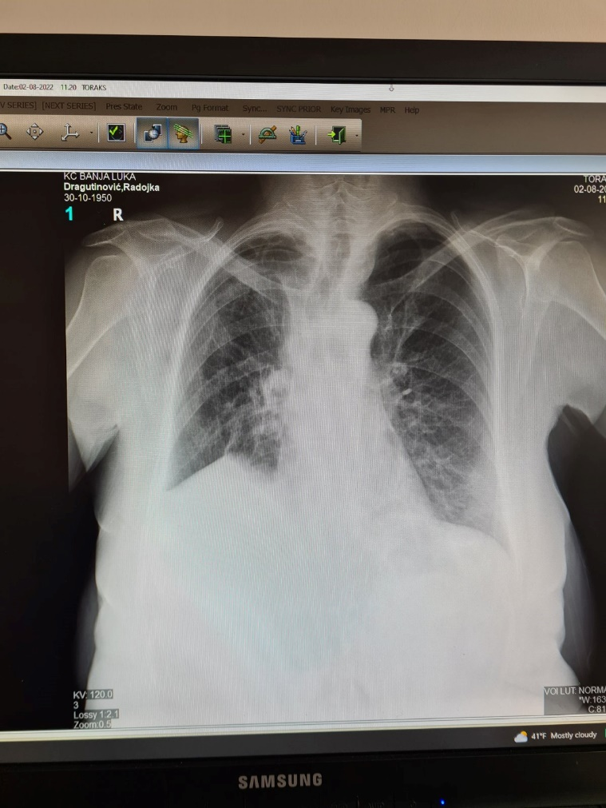
Decision for sutturing tracheal wall – already in operative field
No air-leak postoperatively
Control bronchoscopy reveal intact membranous wall
sixth day after surgery eighth day after surgery

Slide 5

Even a small laceration of the trachea could be complicated, such as prolonged air leak, respiratory failure, empyema, prolonged hospital stay and cost, and mediastinitis.
We showed that tracheal lacerations in thoracic inlet could be repaired even by minimally-invasive approach such as uniportal VATS.

